Slide 1
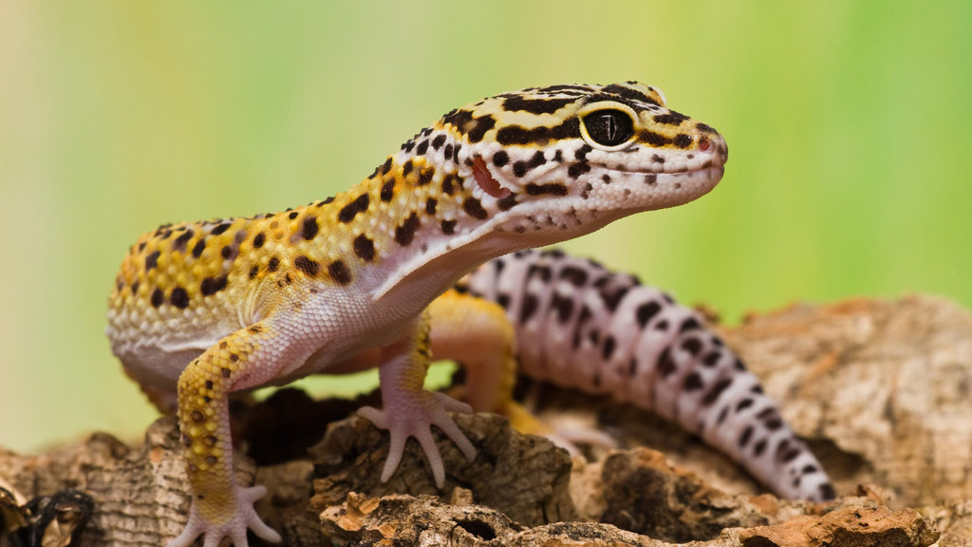
Gecko!
Marco Diaz
Notes:
Talking points go here.

Slide 2
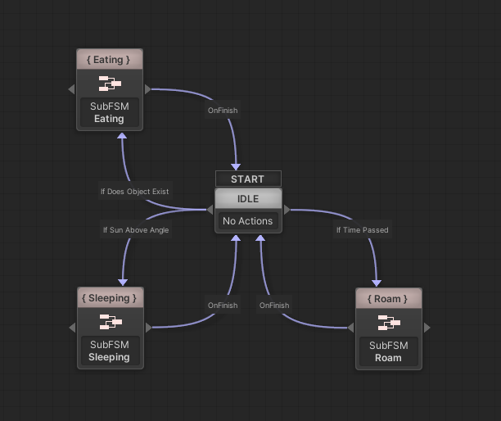
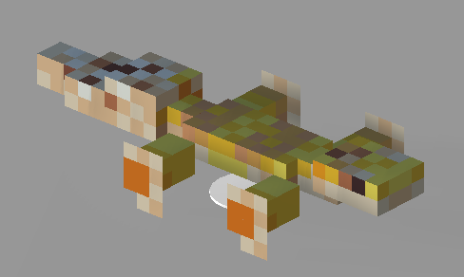
State Machine & SubFSM
State machine controls
active behavior
Sub FSMs describe behaviors
Notes:
Talking points go here.

Slide 3
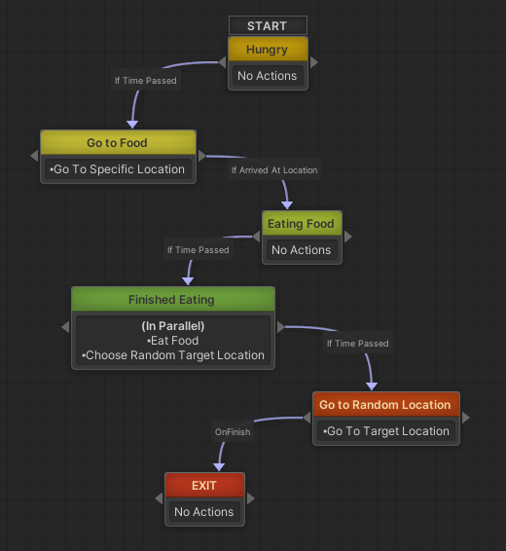
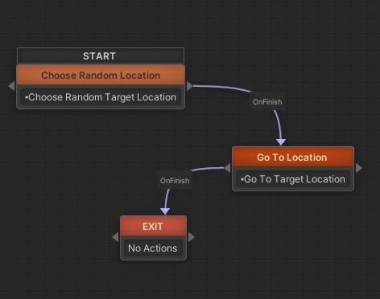
Roam
Notes:
Talking points go here.

Slide 4
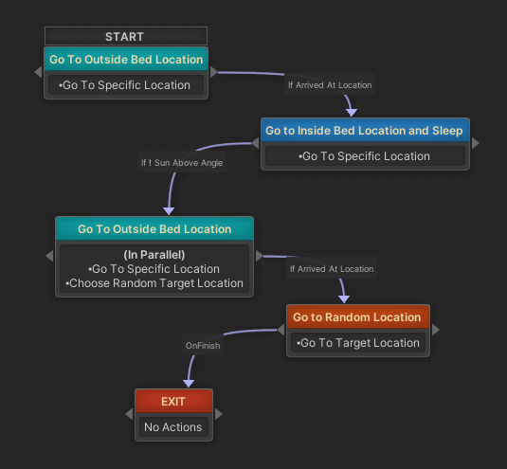
Sleeping
Notes:
Talking points go here.

Slide 5
Eating
Notes:
Talking points go here.

Slide 6
Advanced Motion
Procedural Animation (build time!)
Notes:
Talking points go here.

Slide 7

Outro
Inverse Kinematics, Procedural animations
Thanks for listening! :D
Notes:
Talking points go here.

